Slide 1
ERNIE1: Enhanced Representation through Knowledge Integration
https://arxiv.org/pdf/1904.09223.pdf

Slide 2
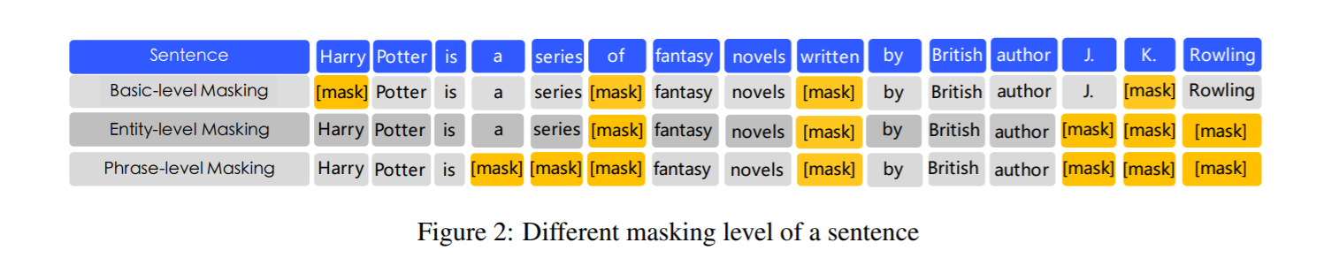
Improvement comparing with bert
ERNIE is designed to learn language representation enhanced by knowledge masking strategies, which includes entity-level masking and phrase-level masking.

Slide 3
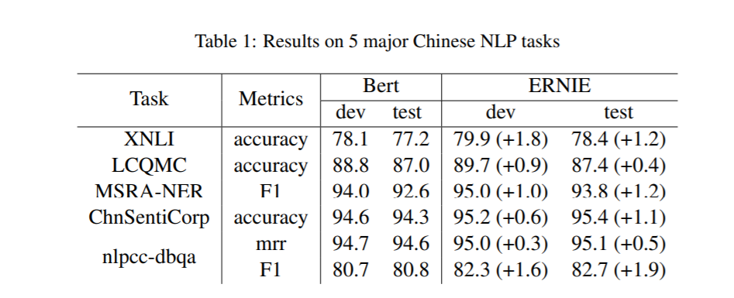
Why it is better after adding phrase and name-entity masking
In this paper, we propose a model called ERNIE (enhanced representation through knowledge integration) by using knowledge masking strategies. In addition to basic masking strategy, we use two kinds of knowledge strategies: phrase-level strategy and entity-level strategy. We take a phrase or a entity as one unit, which is usually composed of several words. All of the words in the same unit are masked during word representation training, instead of only one word or character being masked. In this way, the prior knowledge of phrases and entities are implicitly learned during the training procedure. Instead of adding the knowledge embedding directly, ERNIE implicitly learned the information about knowledge and longer semantic dependency, such as the relationship between entities, the property of a entity and the type of a event, to guide word embedding learning. This can make the model have better generalization and adaptability.

Slide 4
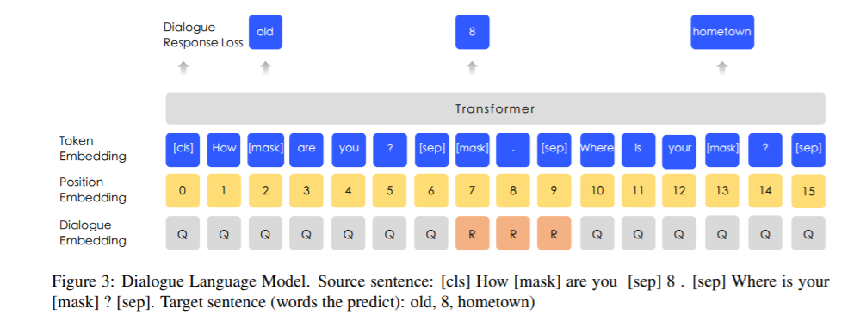
Heterogeneous Corpus Pre-training and DLM
Heterogeneous Corpus Pre-training,
Corpus: Chinese Wikepedia, Baidu Baike, Baidu news and Baidu Tieba
Task: Basic-level Masking (MLM), Entity-level Masking, Phrase-level Masking ,DLM
DLM (Dialogue Language Model),
ERNIE’s Dialogue embedding plays the same roles as token type embedding in BERT, except that ERNIE can also represent multi-turn conversations (e.g. QRQ, QRR, QQR, where Q and R stands for ”Query” and ”Response” respectively). Like MLM in BERT, masks are applied to enforce the model to predict missing words conditioned on both query and response. What’s more, we generate fake samples by replacing the query or the response with a randomly selected sentence. The model is designed to judge whether the multi-turn conversation is real or fake.
Q: Query
R: Response

Slide 5
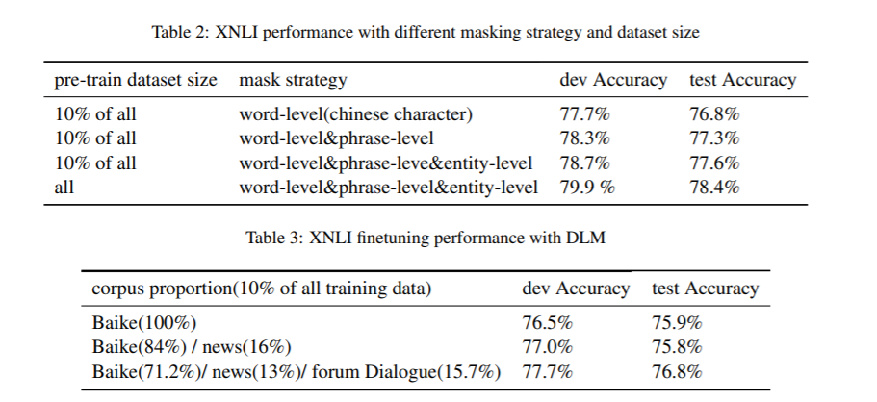
Ablation Studies

Slide 6
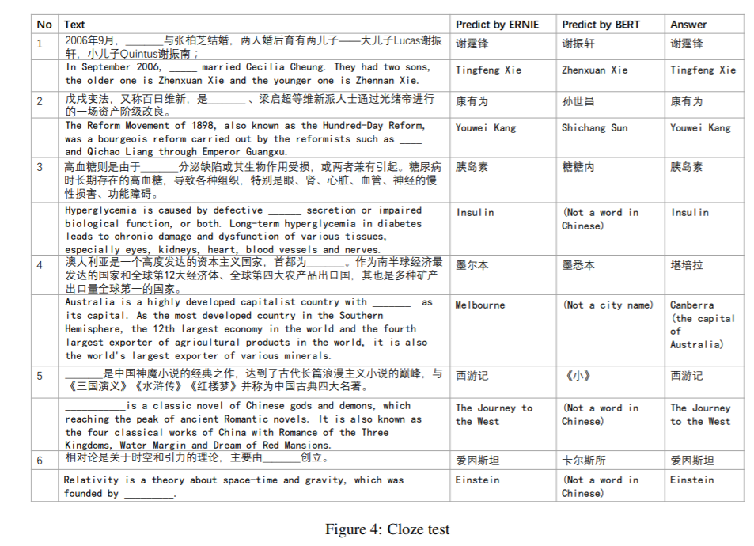
Cloze test

Slide 7
Conclusion
In future we will integrate other types of knowledge into semantic representation models, such as using syntactic parsing or weak supervised signals from other tasks. In addition We will also validate this idea in other languages.

